Slide 1

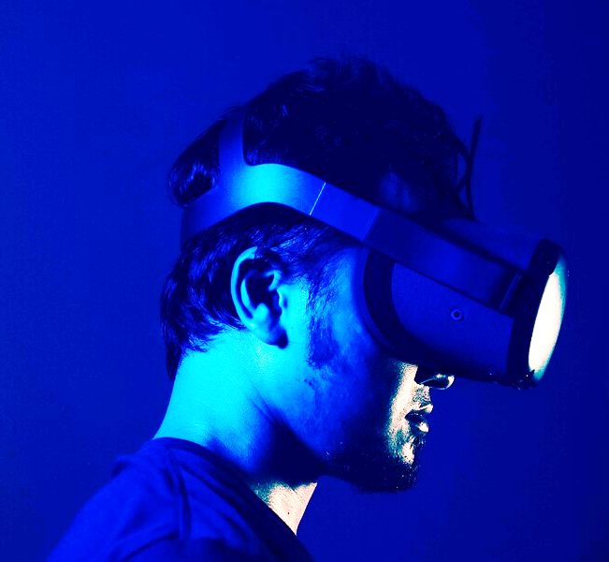

“Techno-Social Excellence”
Marathwada Mitramandal’s Institute of Technology, Lohgaon, Pune-47
“Towards Ubiquitous Computing Technology”
Department of Computer Engineering
Project Stage 1
META-Tourism
Presented by
Mr. Ronit Sharad Narawade - Roll No: BEB01
Mr. Aditya Suresh Patil - Roll No: BEB06
Mr. Yash Devendra Patil - Roll No: BEB11
Ms. Sawri Rajesh Choudhari - Roll No: BEB29
Under the Guidance of
Dr. Subhash.G.Rathod

Slide 2

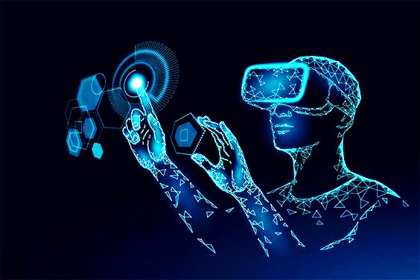
Contents
Introduction
Motivation
Problem Definition
Literature Survey
Architectural Diagram & Other relevance
Algorithm & Other relevance
Mathematical Modeling
NP/NP-P/NP-Hard/NP Complete Analysis
DFD & relevance
UML Modeling
Advantages
Disadvantages
Applications
Future Scope
Conclusion
References

Slide 3

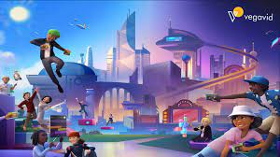
Introduction
"Meta-Tourism” is an ambitious plan that ushers in a new era of travel and exploration by combining physical and digital spaces
The beauty of Meta-verse travel extends beyond serving as an alternative means of journeying; it represents an entirely new and transformative channel for exploration, learning, and connectivity.
Virtual universe travel is not just another way to travel, but an additional and new way to explore, learn and connect.
This innovative initiative is not limited to leisurely tourism but harbors ambitions to foster cultural exchange, preserve heritage, and address environmental sustainability. It presents an exciting prospect for individuals with limited mobility, offering them the opportunity to embark on journeys previously thought to be impossible.
Meta-Tourism 3

Slide 4

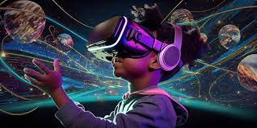
Motivation
Developing a Meta-tourism project represents an exciting fusion of technology and travel, offering a myriad of compelling motivations. First and foremost, it champions global accessibility, effectively dismantling geographical constraints and granting people worldwide the ability to virtually explore destinations.
The metaverse is a fertile ground for fostering cultural exchange. It provides a platform for immersive experiences where users can engage with diverse cultures, traditions, and historical sites, nurturing a global sense of understanding and appreciation.
Environmental sustainability also stands as a driving force. Given the environmental concerns tied to physical travel, the metaverse offers a sustainable alternative
The business potential is substantial, spanning the creation and sale of virtual goods, services, and experiences. Entrepreneurs can explore partnerships with real-world tourism entities or collaborate with local artists and creators, opening up new revenue streams
Meta-Tourism 4

Slide 5

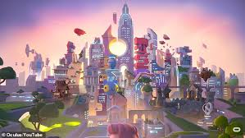
Problem Definition
Meta-tourism, the use of metaverse technologies to create immersive travel experiences, faces technical challenges such as the cost of VR/AR hardware, lack of metaverse standardization, and ethical concerns around accessibility and fraud. Addressing these challenges will enable meta-tourism to reach its full potential as a more accessible, equitable, and ethical way to travel. The need to ensure that meta-tourism experiences are accessible to everyone and that users are protected from fraud and abuse Achieving seamless connectivity and interaction between various virtual environments and platforms within the meta works while maintaining a consistent user experience. Ensuring that the infrastructure supporting the metaverse can handle a growing user base and the increasing complexity of virtual environments. Establishing secure and user control digital identities while addressing a privacy concern related to the collection and use of personal data within the metaphors.
Meta-Tourism 5

Slide 6

Literature Survey
Sr. No. | Title | Publish Year | Authors | Findings
1. | Metaverse as a disruptive technology revolutionising tourism management and marketing. | 2023 | Buhalis, D., Leung, D., & Lin, M. | The Metaverse employs diverse technologies like real-time rendering, physics simulation, networking, and AI to craft immersive virtual worlds. Emerging technologies like VR, AR, and XR further enhance it. These tools enable novel tourism experiences like virtual tours, personalized suggestions, and digital passports.
2 | Meta-tourism for sustainable tourism development | 2023 | Go, H., & Kang, M. | The primary objective of this study is to offer a comprehensive definition of "Meta-tourism" and to present an analytical perspective on this emerging concept. The research also intends to investigate the potential of Meta-tourism in the context of promoting sustainability within the tourism industry.
3 | The metaverse in the hospitality and tourism industry: An overview of current trends and future research directions | 2023 | Gursoy, Dogan, Suresh Malodia, and Amandeep Dhir | A conceptual framework for creating metaverse experiences, identifying research gaps, and proposing agenda items with the potential to significantly benefit hospitality and tourism industry players

Slide 7
Literature Survey
Sr. No. | Title | Publish Year | Authors | Findings
4 | Security and privacy in metaverse: A comprehensive survey. | 2023 | Huang, Yan, Yi Joy Li, and Zhipeng Cai. | The Metaverse is defined by its socialization, immersive interaction, real-world construction, and expandability. While these traits create a captivating digital world, they also introduce security and privacy risks, including data leakage and unauthorized access. This paper reviews the Metaverse's progress and applications across economic sectors.
5 | How Metaverse-Virtual Reality-Can Facilitate the Emergency Remote Teaching | 2022 | Sumardani, D., & Sumardani, N. I. | The Metaverse can transform ERT with immersive and collaborative learning, yet challenges in accessibility, cost, and pedagogy require attention. Educators should prepare by exploring Metaverse's teaching potential, training staff, and collaborating with key stakeholders to facilitate its widespread adoption in emergency remote teaching.

Slide 8


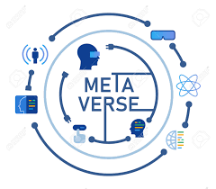





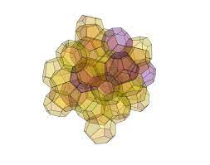

Architectural Diagram & Other relevance
VIRTUAL TOURISM WORLD
METASERVER
MetaDB
User Profile
Tourist History
Location Id
Time
User ID
Traveller Review
Location Id
Time
User ID
Activities
Tourism Score
WEB
HTTP request
Location Id
Location Id
Location Id
Location Id
Login page
WebGL
3D Characters
3D Objects
3D Scene
3D Characters
3D Objects
3D Scene
3D Characters
3D Objects
3D Scene
Tourist Personal info
Performance of Metaverse System
Tourist Satisfaction

Slide 9

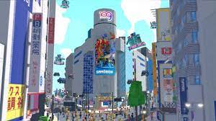
Algorithm & Other relevance
AI algorithm in the Metaverse:
In the metaverse, an artificial intelligence (AI) algorithm is a collection of rules that uses machine learning and artificial intelligence to evaluate user behaviour and offer individualised recommendations, speed up transactions, and improve the user experience. Using web3 and blockchain technology, these algorithms are created to operate in a decentralised and safe environment.
Graphics Rendering Algorithms:
Real-time rendering algorithms are essential for creating realistic and immersive virtual environments. Techniques such as ray tracing and rasterization are employed to generate high quality graphics in real-time.
Rasterization:
Converts vector graphics or 3D models into pixel-based images.
Ray Tracing:
Simulates realistic lighting, shadows, and reflections by tracing the path of light rays.
Shading:
Determines pixel color and brightness based on light interaction with surfaces.
Hidden Surface Removal:
Identifies and renders only visible parts of a 3D scene.
Anti-Aliasing:
Minimizes jagged edges and visual artifacts for smoother images.

Slide 10
Algorithm & Other relevance
Networking Algorithms:
In multiplayer metaverse environments, networking algorithms are crucial for ensuring smooth communication between users. This includes algorithms for data synchronization, latency reduction, and load balancing.
Social Interaction Algorithms:
Algorithms are used to facilitate social interactions within the metaverse, such as matchmaking algorithms for connecting users with similar interests, chat algorithms for real-time communication, and algorithms for managing virtual economies.
Navigation Algorithms:
Navigation algorithms are essential for both characters and users to move seamlessly within the virtual environment. Pathfinding algorithms help characters find optimal routes, while teleportation or locomotion algorithms enhance the user's navigation experience.

Slide 11

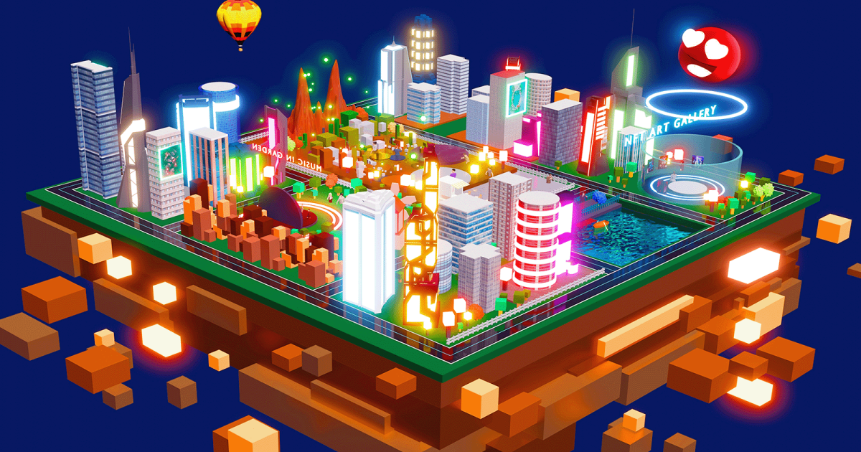
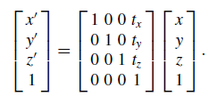
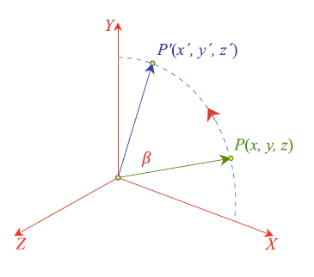
Mathematical Modeling
3D Transforms:
Now we come to transforms in three dimensions, where we apply the same reasoning as in two dimensions. Scaling and translation are basically the same, but where in 2D we rotated a shape about a point, in 3D we rotate an object about an axis.
3D Translation
The algebra is so simple for 3D translation that we can simply write the homogeneous matrix directly:
3D Rotation
In two dimensions a shape is rotated about a point, whether it be the origin or some other position. In three dimensions an object is rotated about an axis, whether it be the x-, y- or z-axis, or some arbitrary axis. To begin with, let’s look at rotating a vertex about one of the three orthogonal axes; such rotations are called Euler rotations after Leonhard Euler. Recall that a general 2D rotation transform is given:

Slide 12
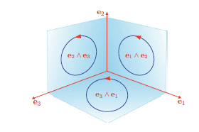
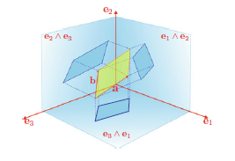
Mathematical Modeling
3D Change of Axes
The ability to reference a collection of coordinates is fundamental in computer graphics, especially in 3D. And rather than investigate them within this section, let’s delay their analysis for the next section, where we see how the technique is used for relating an object’s coordinates relative to an arbitrary virtual camera.
The Geometric Product in 3D
Before we consider the geometric product in 3D we need to introduce some new notation, which will simplify future algebraic expressions. Rather than use i, j and k to represent the unit basis vectors let’s employ e1, e2 and e3 respectively. This means that can be written
ab = |a||b| cos θ + |a||b| sin θ e1 ∧ e2.
3D Bivectors
The projections on the three bivectors

Slide 13

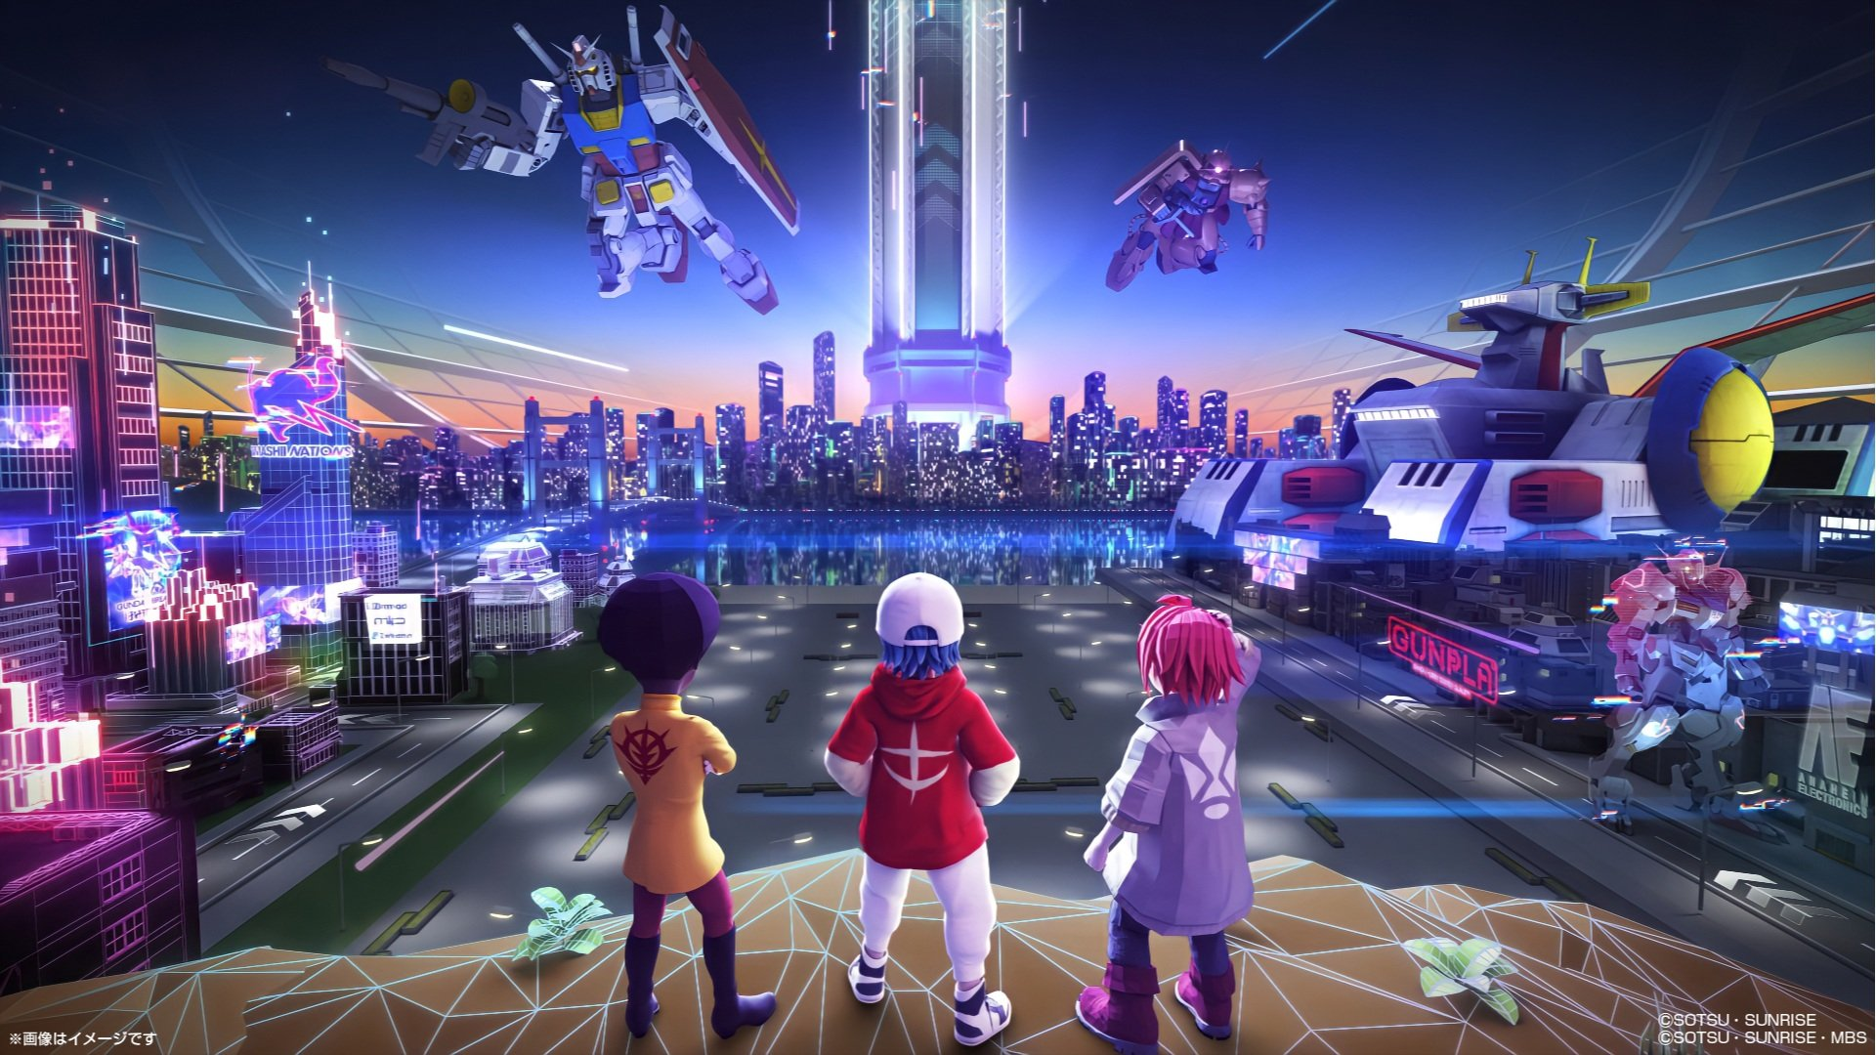
NP/NP-P/NP-Hard/NP Complete Analysis
To perform a comprehensive NP analysis, you would need to identify specific decision problems within the Meta-tourism context and assess their complexity and verifiability. While NP analysis is crucial in theoretical computer science, its practical application to Meta-tourism may vary depending on the system's specific computational challenges and requirements
Analyzing the complexity class NP (Nondeterministic Polynomial Time) in the context of Meta-tourism would depend on the specific computational problems or decision tasks associated with such a system. In computer science, NP primarily deals with decision problems, which are questions with a "yes" or "no" answer.
Here are some considerations when analyzing the NP class in Meta-tourism:
Decision Problems: Determine if there are decision problems within the Meta-tourism system that fall within the NP class. Decision problems could include questions like "Is there a valid booking for a virtual tour on a given date?" or "Is a user's payment information correct?"
Verification: If there are decision problems, can the proposed solutions be efficiently verified in polynomial time? For example, can the system efficiently verify whether a virtual tour booking is valid and paid for?

Slide 14
NP/NP-P/NP-Hard/NP Complete Analysis
Complexity: Consider the complexity of the decision problems. Are there aspects of the Meta-tourism system that lead to NP-complete or NP-hard problems? An example could be optimizing virtual tour schedules or resource allocation.
Reduction: Explore whether problems within the system can be reduced to known NP-complete problems. This would indicate that the system contains NP-complete problems, which are among the hardest problems in NP.
Parallelism and Nondeterminism: Consider whether parallelism or nondeterministic algorithms can be applied to certain problems within the Meta-tourism system. NP problems may benefit from parallel computation or nondeterministic algorithms to expedite verification.

Slide 15
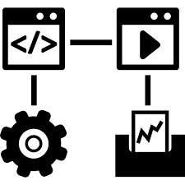
DFD & relevance
DFD level-0

Slide 16
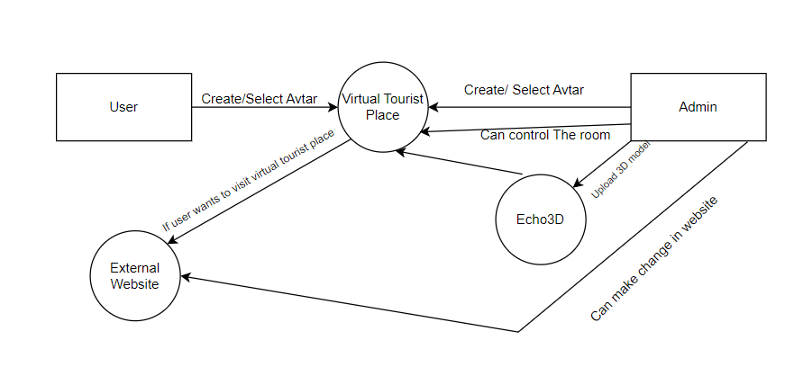
DFD & relevance
DFD level-1

Slide 17
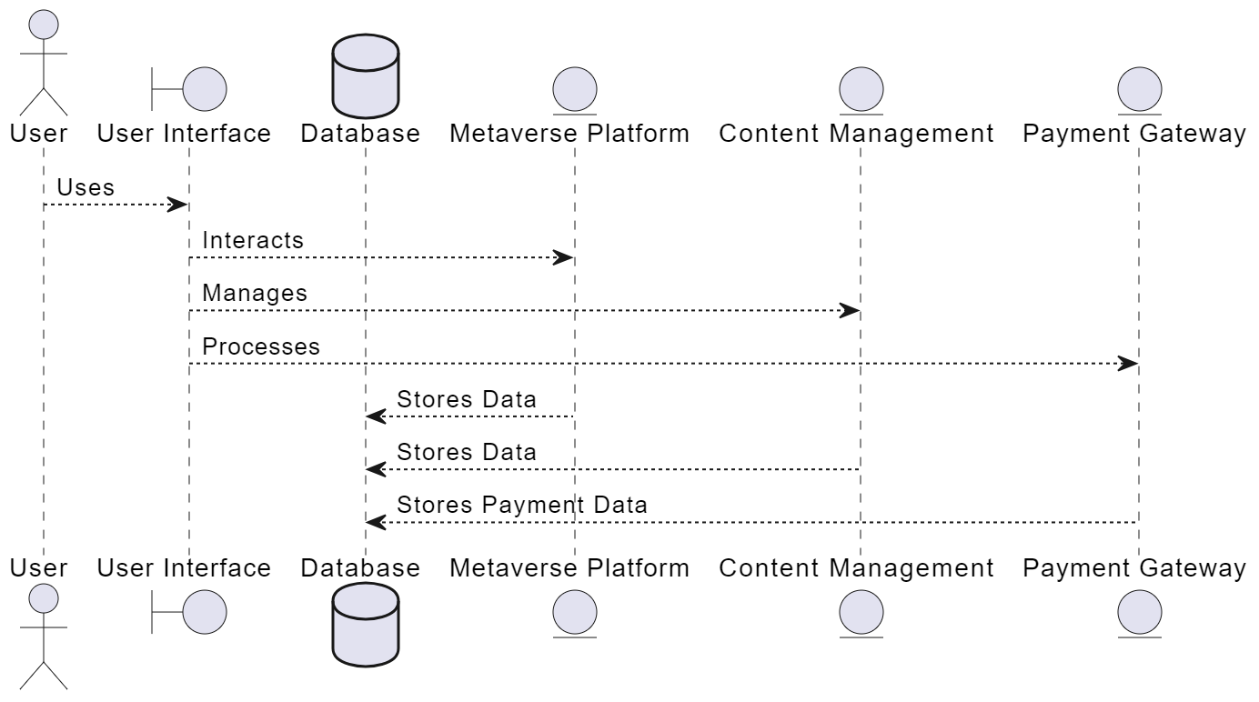
DFD & relevance
DFD level-2

Slide 18

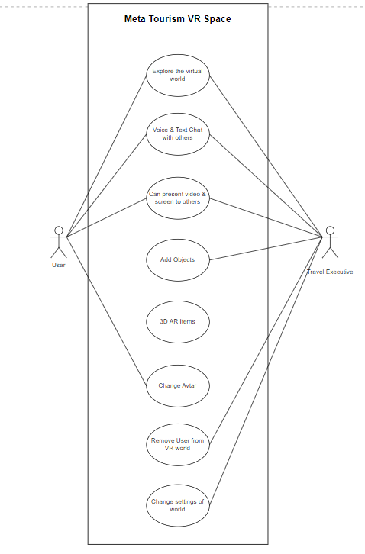
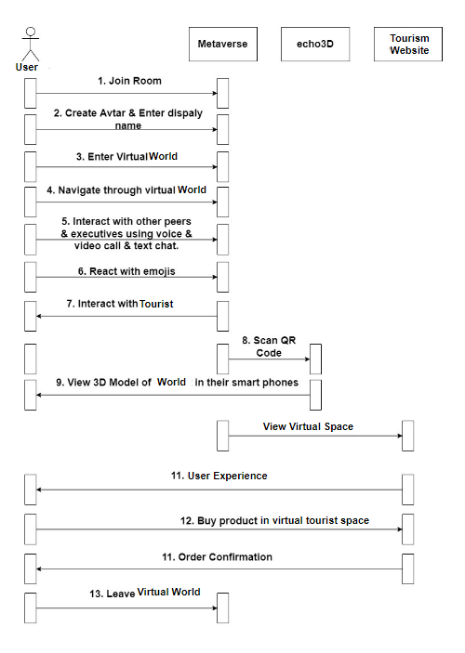
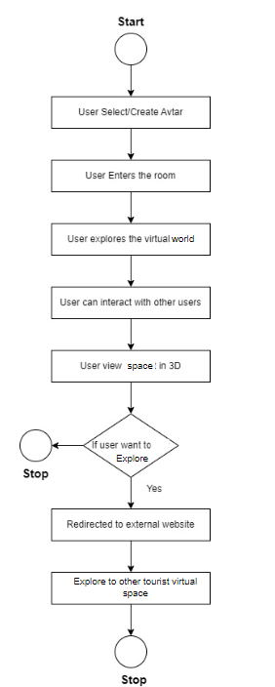
UML Modeling
Use Case Diagram
Sequence Diagram
Activity Diagram

Slide 19
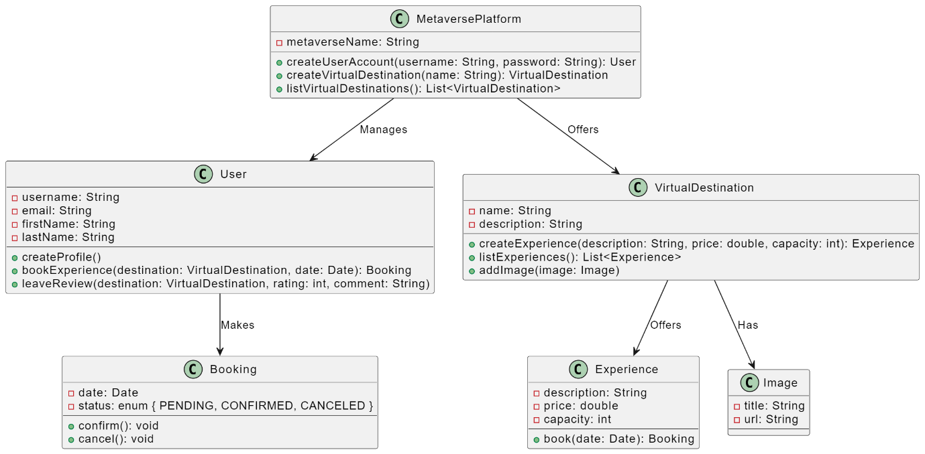
UML Modeling
Class Diagram

Slide 20

Advantages
Global Accessibility: Meta-tourism provides access to virtual destinations, breaking down geographical barriers, making it accessible to people worldwide
Immersive Experiences: Users can enjoy highly immersive and interactive experiences that can simulate real-world travel.
Cultural Exchange: Meta-tourism allows users to explore and learn about different cultures and historical sites, promoting cultural understanding and appreciation.
Environmental Sustainability: It offers a more eco-friendly alternative to physical travel, reducing carbon emissions and environmental impact.
Innovative Education: It serves as an educational tool by offering virtual field trips and interactive learning experiences, making education more engaging.
Creative Storytelling: Developers can craft immersive narratives around destinations, blending history, mythology, and fiction to create compelling virtual tourism experiences.

Slide 21

Disadvantages
Technical Requirements: Meta-tourism relies on advanced technology, including virtual reality (VR) and augmented reality (AR) equipment. This can be a limitation for users who do not have access to the necessary hardware or reliable internet connections.
Content Quality: The quality of virtual destinations and experiences can vary widely. Some may be highly immersive and engaging, while others may lack depth and realism, leading to inconsistent user experiences.
Dependence on Technology: The success of Meta-tourism is highly dependent on technology advancements. Any disruptions or failures in technology can impact the user experience and the reliability of the platform
Lack of Regulation: The Meta-tourism industry is relatively new, and there may be a lack of standardized regulations. This can lead to issues related to content quality, safety, and ethical considerations.

Slide 22

Applications
Virtual Travel Experiences: Meta-tourism allows users to explore virtual replicas of real-world destinations, providing an immersive and interactive way to travel the globe without leaving their homes. Users can visit famous landmarks, historical sites, and exotic locations virtually.
Cultural Exchange: Meta-tourism fosters cultural understanding and appreciation by enabling users to engage with and learn about different cultures, traditions, and historical sites. It provides a platform for cross-cultural interactions and learning.
Environmental Sustainability: As a more sustainable alternative to physical travel, Meta-tourism reduces the carbon footprint associated with tourism. Users can enjoy travel experiences without contributing to environmental impacts, making it an eco-friendly option.
Education: Metatourism serves as an educational tool by offering virtual field trips and interactive learning experiences. It complements traditional education methods, making learning more engaging and accessible to students worldwide.
Creative Storytelling: Developers can craft immersive narratives around virtual destinations, blending history, mythology, and fiction. This creative storytelling enhances the user experience and opens up possibilities for innovative storytelling techniques.

Slide 23

Future Scope
Advanced Immersion: As virtual reality (VR) and augmented reality (AR) technologies evolve, Meta-tourism experiences will become even more immersive. Users can expect higher-quality graphics, improved interaction, and a greater sense of presence, making virtual travel almost indistinguishable from real-world experiences.
Hyper-Personalization: Future metaverse platforms will offer hyper-personalized travel experiences. AI and data analytics will enable platforms to understand users' preferences, allowing for tailored itineraries and content. Users can explore destinations and activities that align with their individual interests.
Seamless Social Interaction: Meta-tourism will continue to prioritize social interaction. Users will engage with friends, family, and fellow travelers in shared virtual spaces. Live events, parties, and gatherings will become commonplace, making virtual tourism a social and recreational activity.
Integration with Real-World Travel: The metaverse and real-world travel will become more interconnected. Users might explore a destination virtually before planning a physical trip or share their virtual experiences with others, inspiring real-world travel.
Global Cultural Exchange: Cultural exchange will thrive as users worldwide can engage with and learn from each other. Virtual museum visits, language lessons, and celebrations of cultural events can occur in shared spaces, fostering understanding and appreciation.

Slide 24

Conclusion
By addressing the gaps identified above, the Meta-verse can be transformed into a thriving new destination for tourists around the world. In addition to the above, here are some specific recommendations for Meta-verse tourism projects: Focus on creating immersive and engaging experiences: Meta-verse tourism experiences should be more than just virtual replicas of real-world destinations. They should be designed to transport users to new and exciting worlds, and to provide them with unique and memorable experiences. Partner with other businesses: Meta-verse tourism projects can benefit from partnering with other businesses, such as technology companies, social media platforms, and other tourism providers. This can help to increase awareness of the project, attract new users, and create more comprehensive and engaging experiences. Be innovative: The Meta-verse is a rapidly changing landscape, and Meta-verse tourism projects need to be innovative in order to stay ahead of the curve. This means constantly exploring new technologies and new ways to create immersive and engaging experiences for users.

Slide 25

References
[1] Buhalis, D., Leung, D., & Lin, M. (2023). Metaverse as a disruptive technology revolutionising tourism management and marketing. Tourism Management, 97, 104724.
[2] Go, H., & Kang, M. (2023). Meta-tourism for sustainable tourism development: Tourism agenda 2030. Tourism Review, 78(2), 381-394.
[3] Gursoy, Dogan, Suresh Malodia, and Amandeep Dhir. "The metaverse in the hospitality and tourism industry: An overview of current trends and future research directions." Journal of Hospitality Marketing & Management 31, no. 5 (2022): 527-534.
[4] Huang, Yan, Yi Joy Li, and Zhipeng Cai. "Security and privacy in metaverse: A comprehensive survey." Big Data Mining and Analytics 6, no. 2 (2023): 234-247.
[5] Sumardani, D., & Sumardani, N. I. (2022). How Metaverse—Virtual Reality—Can Facilitate the Emergency Remote Teaching. Indonesia Post-Pandemic Outlook: Social Perspectives, 289.
[6] Joye, S., & Joye, S. R. (2016). Ethical Implications Of a Virtual Reality Metaverse: The Pribram-Bohm Hypothesis.
[7] Gupta, Ankur, Habib Ullah Khan, Shah Nazir, Muhammad Shafiq, and Mohammad Shabaz. "Metaverse Security: Issues, Challenges and a Viable ZTA Model." Electronics 12, no. 2 (2023): 391.
[8] Volchek, K., & Brysch, A. (2023, January). Metaverse and tourism: From a new niche to a transformation. In ENTER22 e-Tourism Conference (pp. 300-311). Cham: Springer Nature Switzerland.
[9] Ioannidis, S., & Kontis, A. P. (2023). Metaverse for tourists and tourism destinations. Information Technology & Tourism, 1-24.
[10] Huang, X. T., Wang, J., Wang, Z., Wang, L., & Cheng, C. (2023). Experimental study on the influence of virtual tourism spatial situation on the tourists’ temperature comfort in the context of metaverse. Frontiers in Psychology, 13, 1062876.

Slide 26

Thank You

